Slide 1
Multiple
Choice
Questions
Group Number :- 1

Slide 2
Group members
SS Praful Tondomker (IIT2016082)
Manvendra Dattatrey (IIT2016504)
Austin Kispotta (IIT2016051)
Reena Yadav (IIT2016089)
Vikash Kumar (IIT2016041)

Slide 3
Contents :
Introduction
Technology Used
Scope
Description
System Features
Database Design
Future Scope
References

Slide 4
Introduction
This software aims to build and create your online exams & tests with great ease and provide the users with appropriate feedback, so they will have a rich learning experience.
It provides scorecard, rank card, time taken etc which gives a better perspective to evaluate student’s performance in a better way.

Slide 5
Tech Stack
HTML/CSS - For frontend Design
BootStrap - For frontend Design
JavaScript - As backend language
EJS - dynamic HTML page rendering
Node.js - As runtime engine for javascript
MongoDB - For database
Express - Web server for Node.js
Git/GitHub - Version Control

Slide 6
npm libraries
Body Parser - Parse POST request body
Mongoose - Interact with MongoDB from NodeJS
Passport - Add user authentication
Passport-local - Create local authentication stack
Passport-local-mongoose - Link passport to MongoDB

Slide 7
System Features
Self Registration
Let your users sign-up for your exams themselves. No assigning required.
Platform Independent
This software supports any platform: desktop, tablet or mobile.
No Limits
Create unlimited online exams with our software.
Stats and Results
Get complete details of the contests completed.
Set the Timer
Whether or not, the test will be timed, is in setter’s hands.

Slide 8
Description
This software allows test setters to create a contest.
The users, viz. test setters and takers, are required to be registered to use the software.
Any user can create a test as well as can play the role of examinee.
Test taker can view the stats of the test taken, which include score and rankcard.

Slide 9
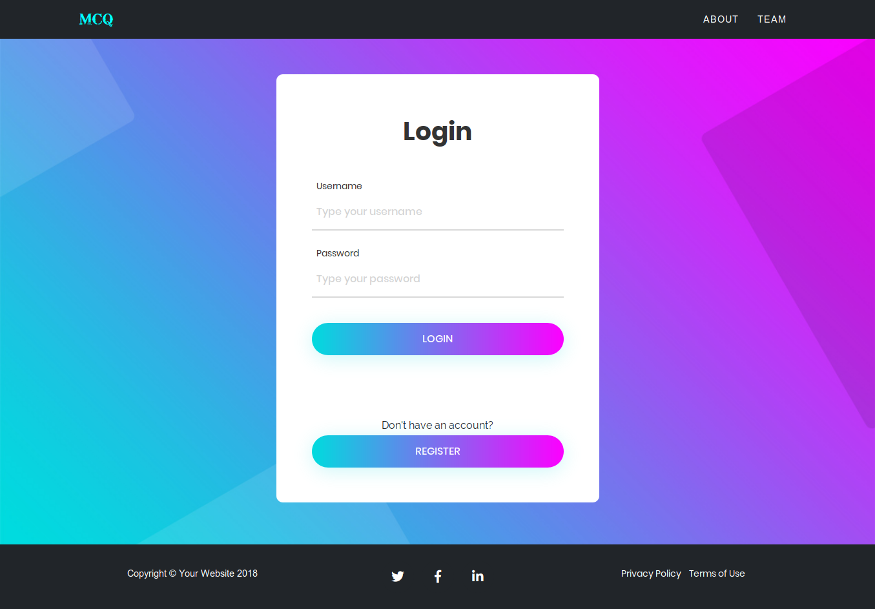
Screenshot of each feature here.

Slide 10
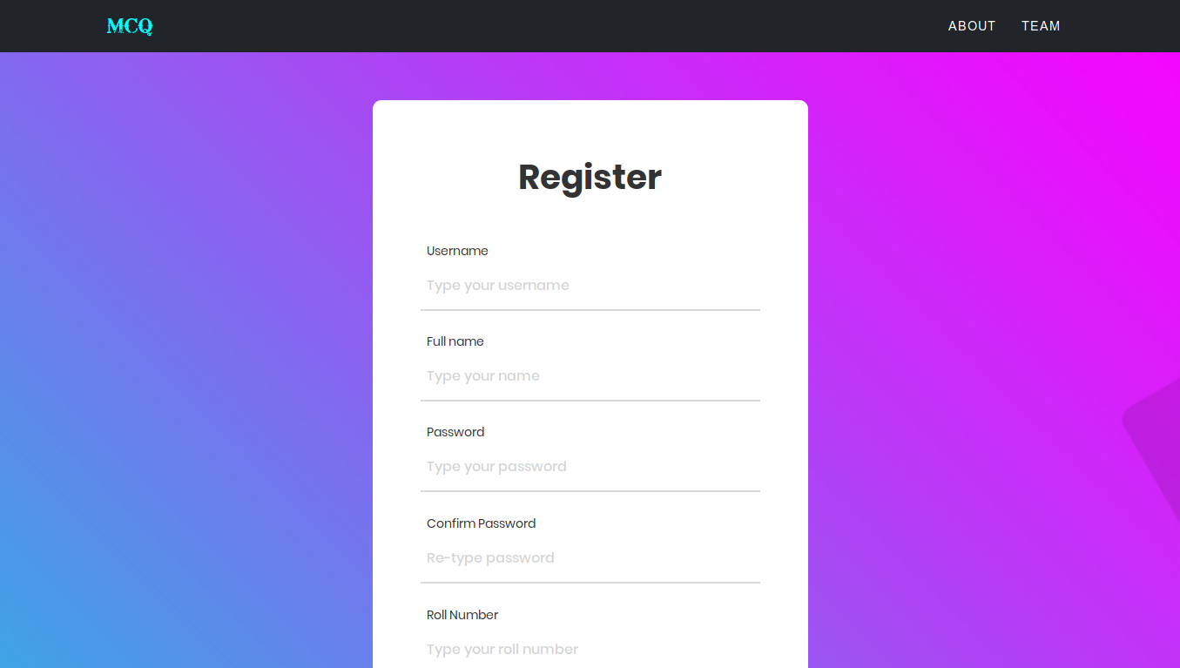

Slide 11
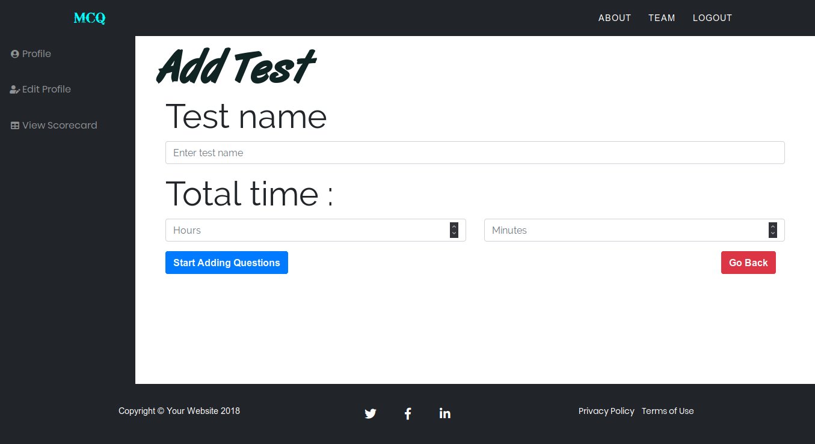

Slide 12
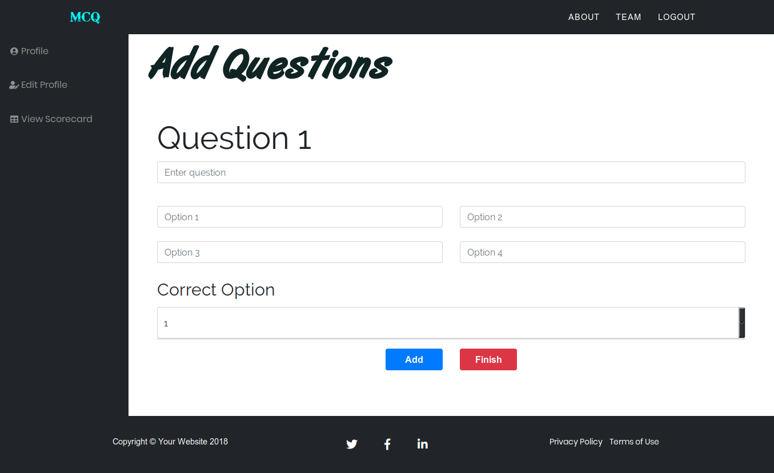

Slide 13
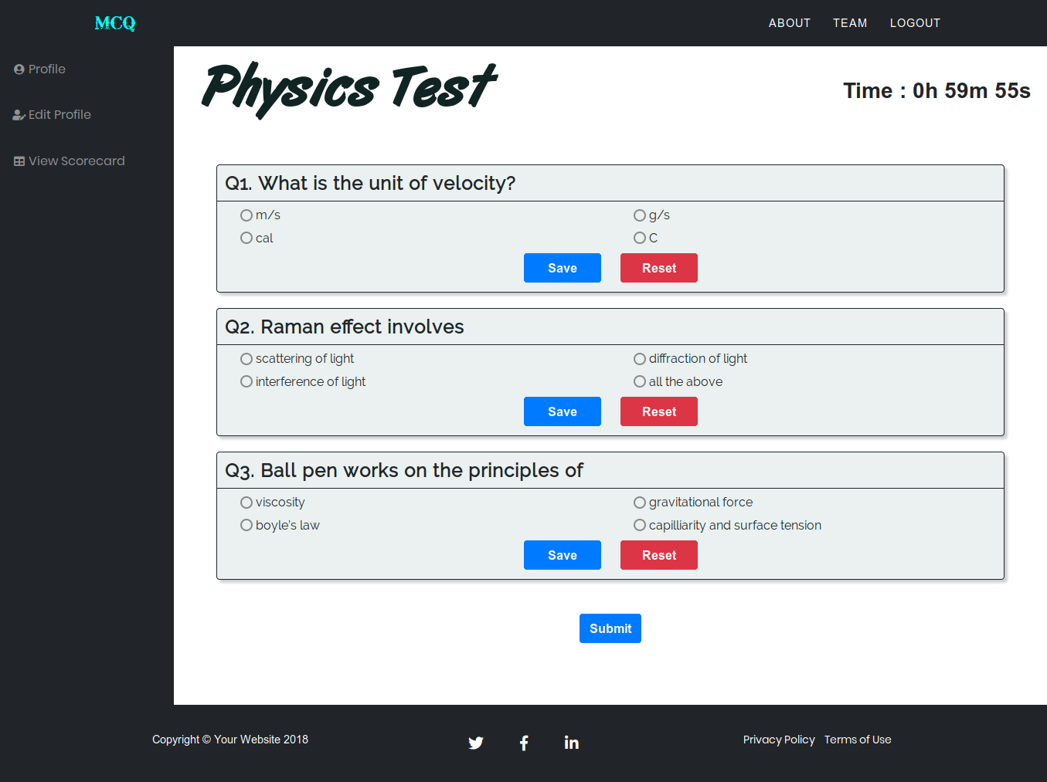

Slide 14
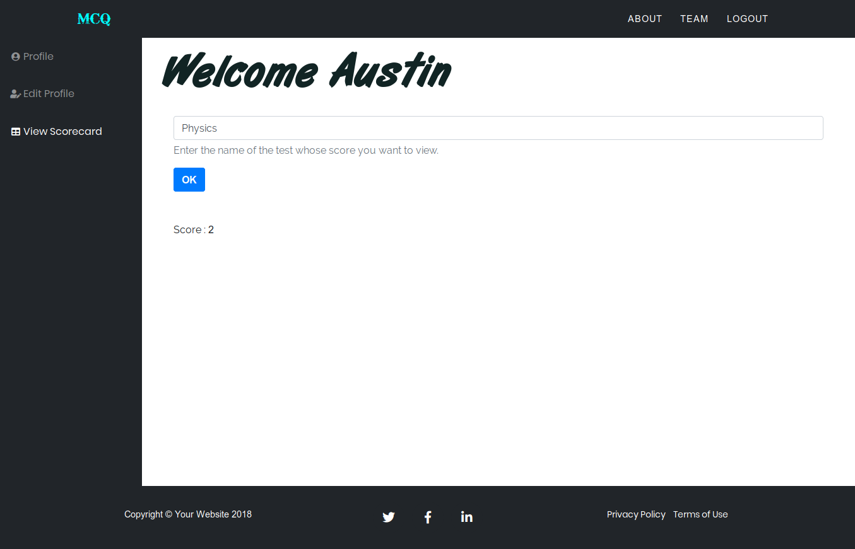

Slide 15
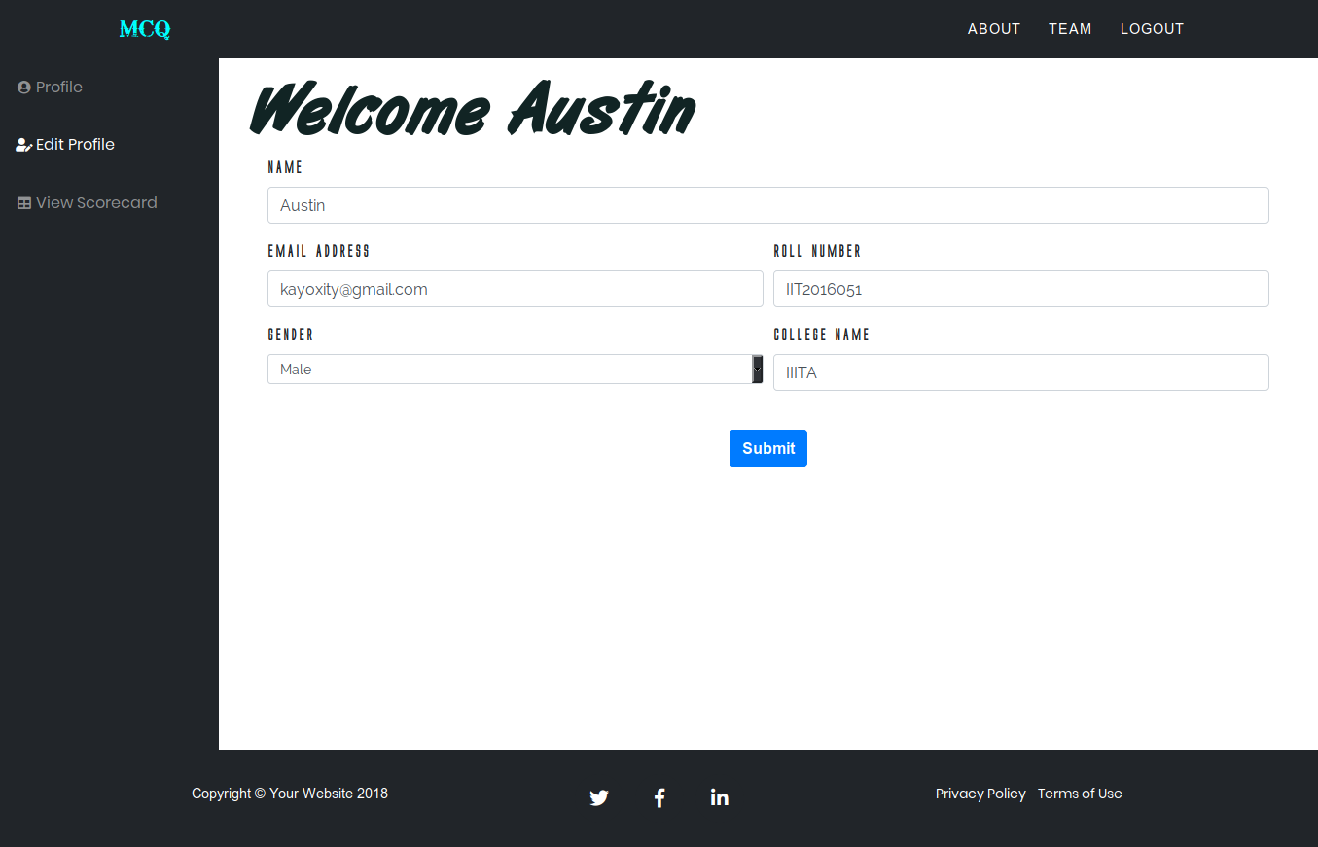

Slide 16
Description
Operating Environment
This software is OS independent software.
It is browser dependent software in which user needs to make sure that JavaScript is enabled in the browser
User Documentation
List the user documentation components (such as user manuals, on-line help, and tutorials) that will be delivered along with the software. Identify any known user documentation delivery formats or standards. Install all the requirements as mentioned in github readme.md.
Follow all the steps given in the readme : ReadMe

Slide 17
Database Design
The database used is MongoDB, which is a non-relational database.
We have used 2 models in total :
Test
User
Each of these models are explained in the next slides.

Slide 18
Database Design
User model
realname | String
username | String
password | String
tests | [testSchema]
type | String
gender | String
roll | String
college | String
email | String
testSchema
testname | String
score | Number
taken | Boolean

Slide 19
Database Design
questionSchema
question | String
op1 | String
op2 | String
op3 | String
op4 | String
ans | String
Test model
name | String
questions | [questionSchema]
time | Number

Slide 20
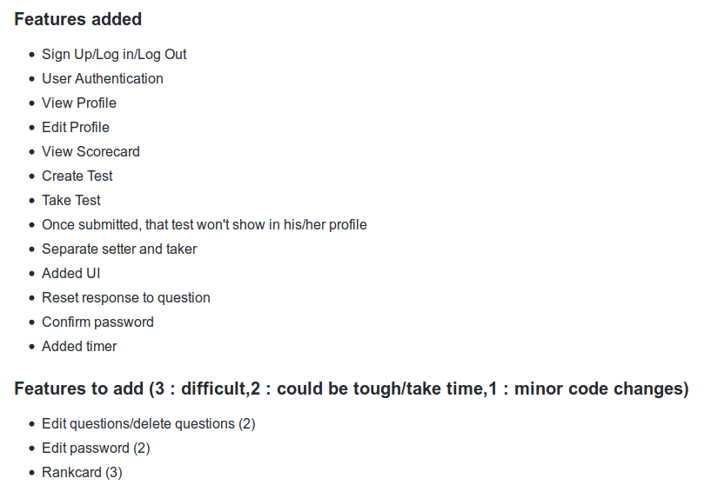
WORK DONE SO FAR...

Slide 21
FUTURE SCOPE
Real Time score board can be implement.
Grade system can be developed for this test.
MCQ website can be host on heroku cloud server, instead of localhost.

Slide 22
References
NodeJS Documentation - https://nodejs.org/en/docs
Bootstrap - https://getbootstrap.com/docs/4.1/getting-started/introduction/
MongoDB Manual - https://docs.mongodb.com/manual/

Slide 23
Thank you!

